Slide 1



Predicting student dropout in higher education
Developers Institute
Data Analytics
Course DA 157
Florencia Ogorinsky

Slide 2



IMPACT OF HAVING FEWER GRADUATES
Lost time and money: Many students invest years and financial resources without obtaining a degree
Frustration and demotivation: Dropping out can negatively impact mental health
Lower rankings and reputation: Retention and graduation rates are key quality metrics for academic institutions
Financial loss: Fewer graduates may mean less revenue from alumni donations, postgraduate programs, or continued enrollment
Less qualified workforce: Fewer graduates lead to talent shortages in critical areas like healthcare, education, and tech
Increased social inequality: Higher education is a key driver of social mobility. A high dropout rate widens the gap between socioeconomic classes
Wasted public investment: If governments fund education but students don’t graduate, it results in inefficient use of public resources

Slide 3


DATASOURCE
The dataset contains 4,424 student records and 35 columns, covering:
Demographics: age, gender, marital status, nationality
Academic background: previous qualification, admission mode/order Socioeconomic indicators: parents’ education and occupation, whether the student is a debtor, scholarship holder, etc.
Academic performance: grades, approved/evaluated/enrolled subjects in both semesters
Macroeconomic variables: unemployment rate, inflation, GDP Target: Student status – Dropout, Enrolled, or Graduate
KAGGLE DATASET
COLUMN DESCRIPTION AND ENCODING

Slide 4
APPLIED PROCESSES
Data Preprocessing
-Renaming columns for clarity
-Handling outliers using Z-score and imputation
-Normalizing skewed distributions using log and Box-Cox transformations
-Encoding the target variable numerically:
Dropout = 0
Enrolled = 1
Graduate = 2
Analysis & Modeling
-Visualized dropout distribution
-Evaluated feature correlations with the target
-Discovered course-specific dropout patterns
-Feature Importance
-Calculated correlations between features and target, both globally and per course
-Exported correlations to Excel for Power BI visualization
-Trained models to predict dropout risk
-Evaluated model performance using classification metrics and confusion matrix
Power BI Dashboard
-Final insights were visualized using Power BI.
-Each academic course was analyzed individually to identify the most impactful dropout factors. This approach allows institutions to create tailored intervention strategies.

Slide 5
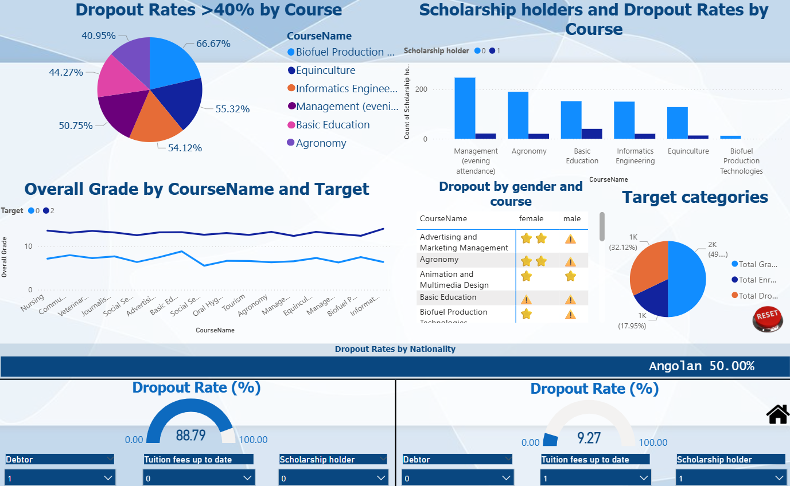
DATA PREPROCESSING

Slide 6

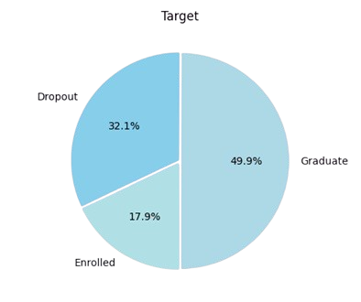
HOW TO IMPROVE THE MODEL
Collect more data for underrepresented programs and categories, such as Enrolled
Include more variables like attendance
Use ML models inside every subgroup of the data (split by courses)

Slide 7




LINKS

